Slide 1
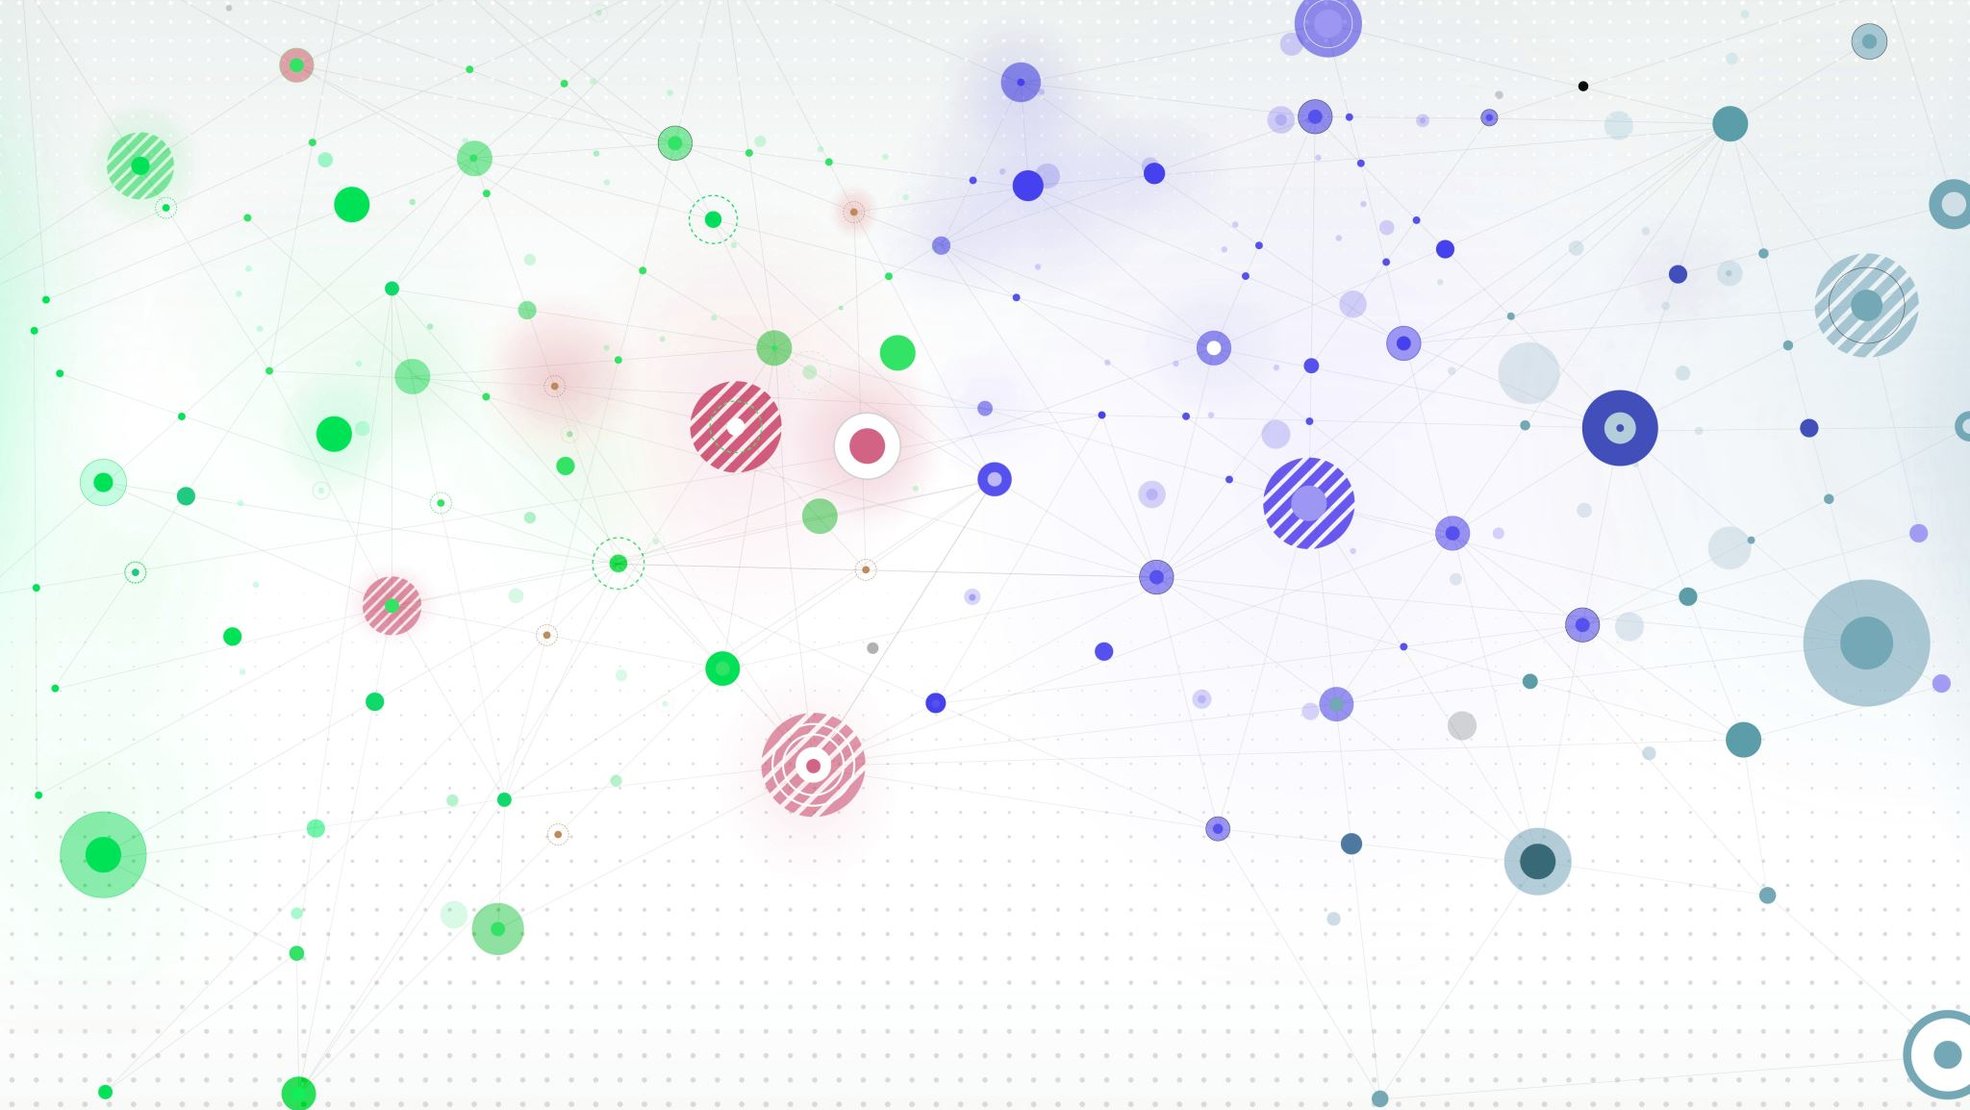
Hospital Management System
By
Siddhardha Chedella
Vineetha Mallu
Gnana Kumari Yadlapati
Priyanka Kuncham

Slide 2
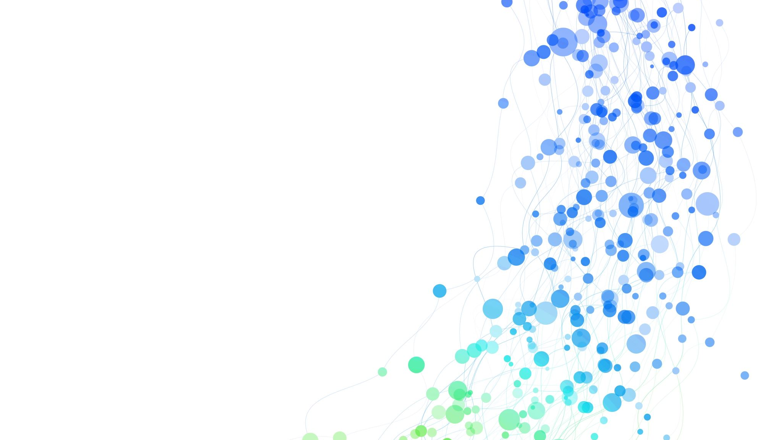
Introduction
Hospitals interact with a lot of people in a day and there are various activities involved in day-to-day operations of hospitals.
A Hospital Management System (HMS) is a software solution designed to streamline and optimize all aspects of a hospital's operations. It acts as a central hub for managing patient data, administrative tasks, and clinical activities.

Slide 3

Aim
Develop a modern, web-based hospital management system that offers a user-friendly interface.
Interaction between patients, doctors, staff are managed and administrated by Administrator.
It is used to manage the following information. Patient information, Doctor Availability, scheduling an appointment for patient and etc.

Slide 4
Technologies Used:
Frontend : React.js
Backend : Node.js, Express
Database : MySQL

Slide 5
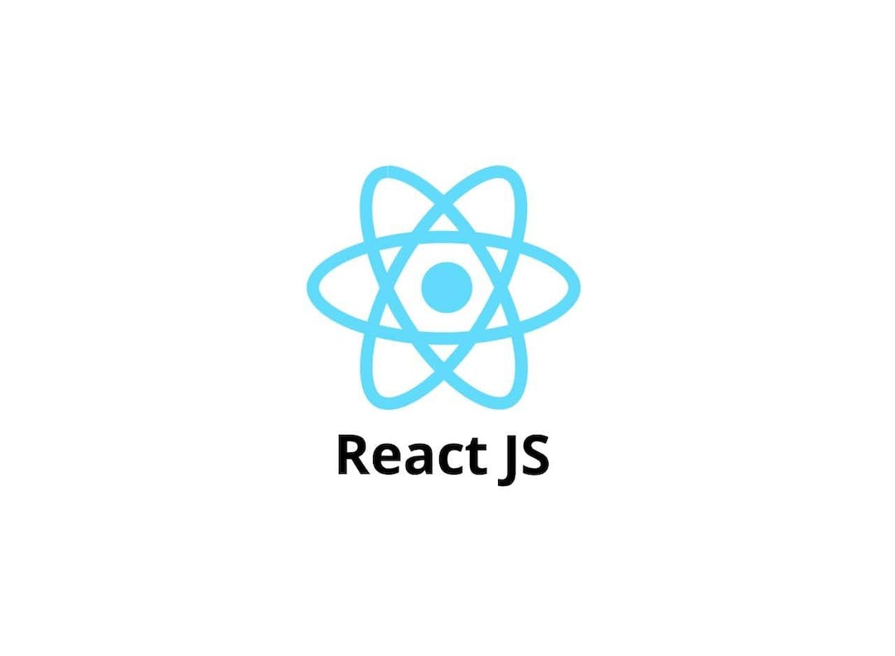
React JS
React.js is a JavaScript library used for building user interfaces, particularly for web applications.
It allows developers to create interactive, dynamic UIs efficiently by breaking down the interface into reusable components.
React.js also has a vibrant ecosystem with a wide range of tools, libraries, and community support, making it an excellent choice for developing modern web applications.
Additionally, React.js promotes a declarative approach to building UIs, where developers describe what the UI should look like

Slide 6
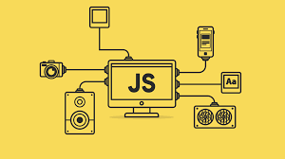
Java script
JavaScript is the core programming language used in React.js for creating dynamic and interactive user interfaces.
JavaScript handles user interactions and events within React components
JavaScript is used to fetch data from external sources such as APIs.
JavaScript is essential in React.js for creating dynamic, data-driven user interfaces and handling user interactions effectively.

Slide 7
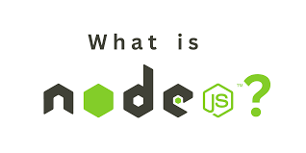
Node JS
Node.js plays a crucial role in React applications by serving as the runtime environment for running server-side code and building a backend for React applications.
Node.js enables server-side rendering of React components, allowing the application to generate HTML on the server before sending it to the client.
Node.js provides a runtime environment for running development servers, facilitating hot reloading and fast iteration during React application development.

Slide 8

My Sql
MySQL holds significant importance in the field of Database Management Systems (DBMS) due to its reliability, performance, scalability, and cost-effectiveness.
MySQL offers a stable and efficient platform for managing data, making it a trusted choice for powering mission-critical applications and websites.
Its compatibility with various operating systems and programming languages, combined with extensive community support, further enhances its appeal.

Slide 9

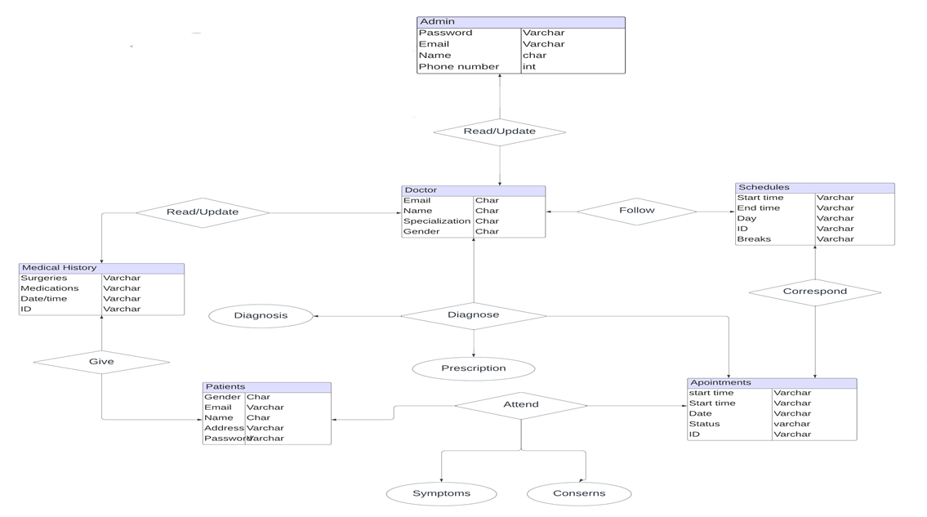
ER Diagram

Slide 10
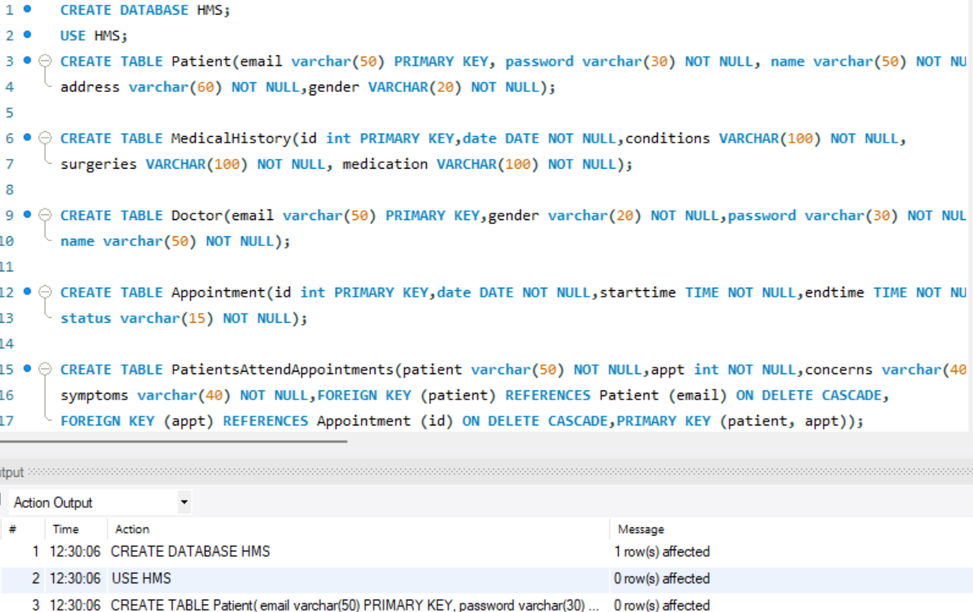
DDL Command Overview

Slide 11
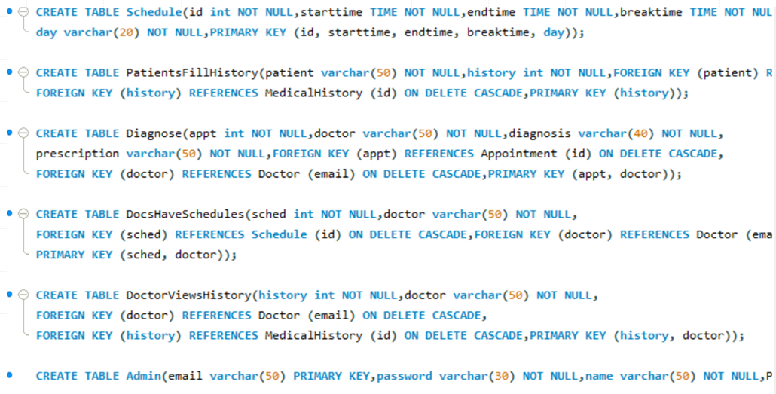

Slide 12
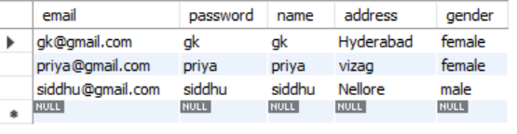
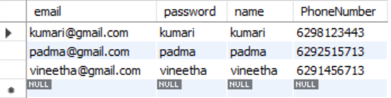
Table Outputs
Patient
Admin

Slide 13
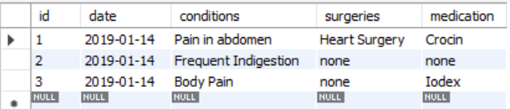
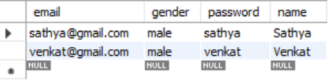
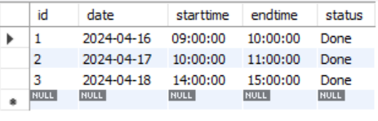
Medical History
Doctor
Appointment

Slide 14
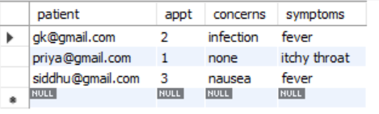
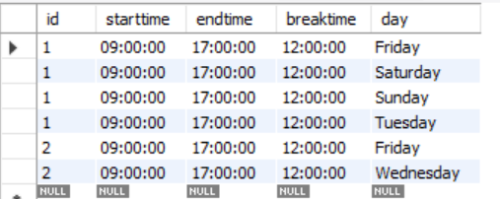
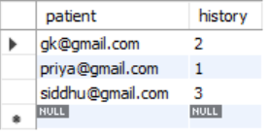
PatientattendAppointments
Schedule
PatientHistory

Slide 15
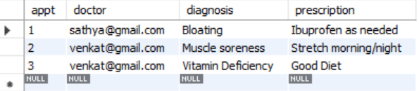
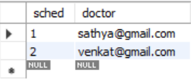
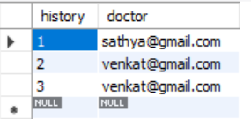
Diagnose
DocsHaveSchedules
DoctorViewsHistory

Slide 16
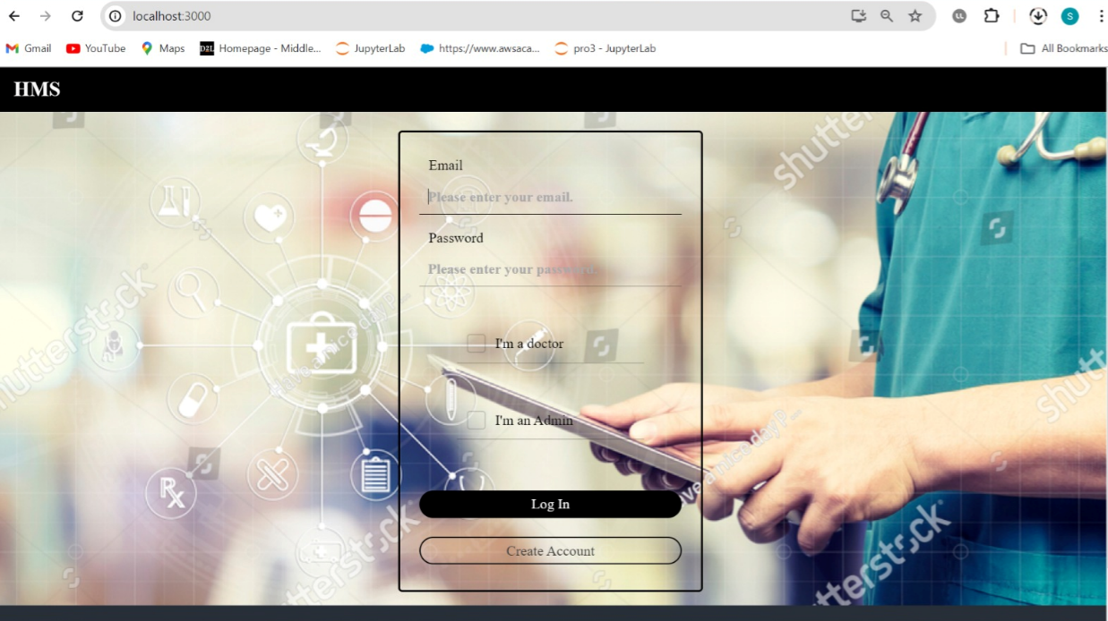
Login Page

Slide 17
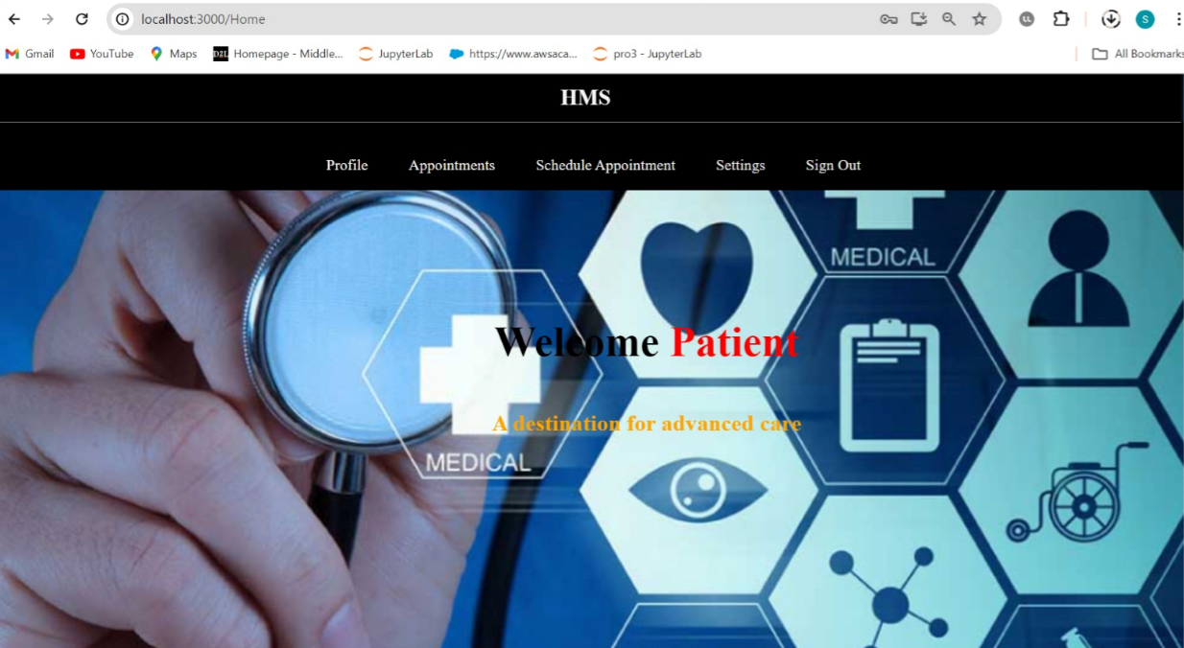
Welcome page

Slide 18
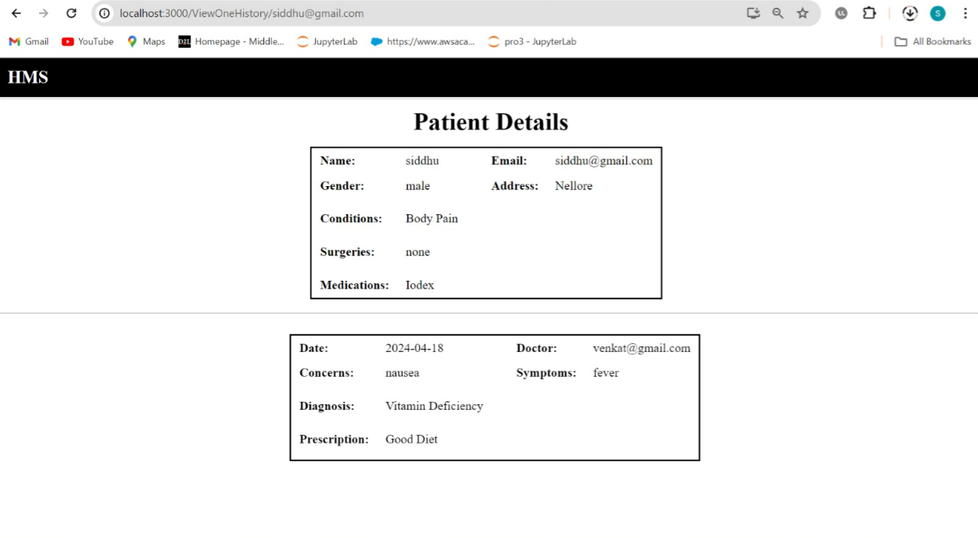
Patient Details

Slide 19
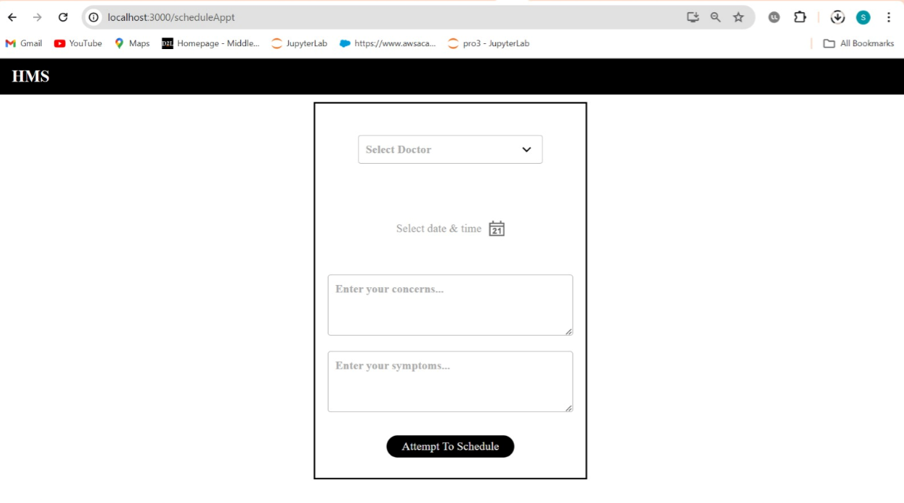
Schedule Appointment Page

Slide 20
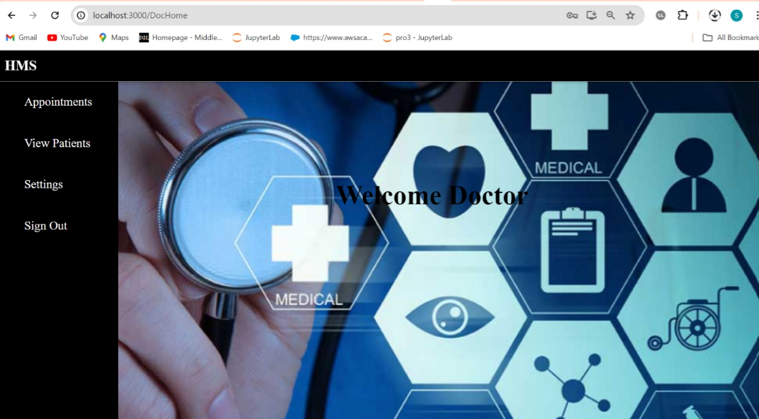
Doctor Welcome Page

Slide 21
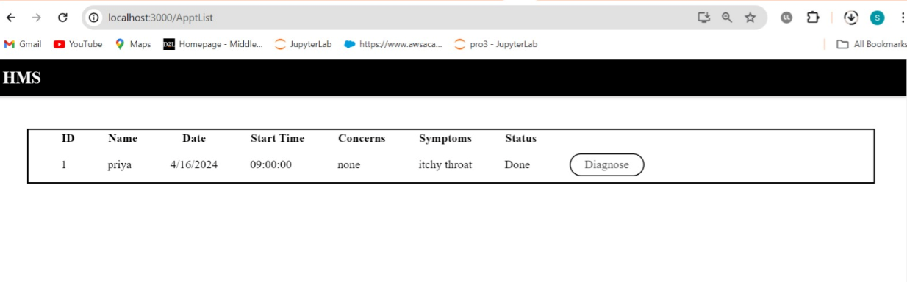
Doctor Having Schedules Page

Slide 22
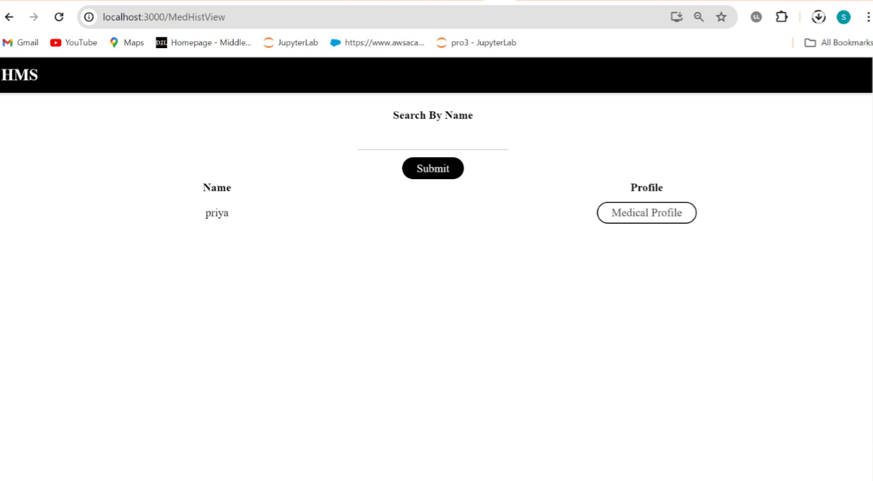
Patients under that Doctor Page

Slide 23
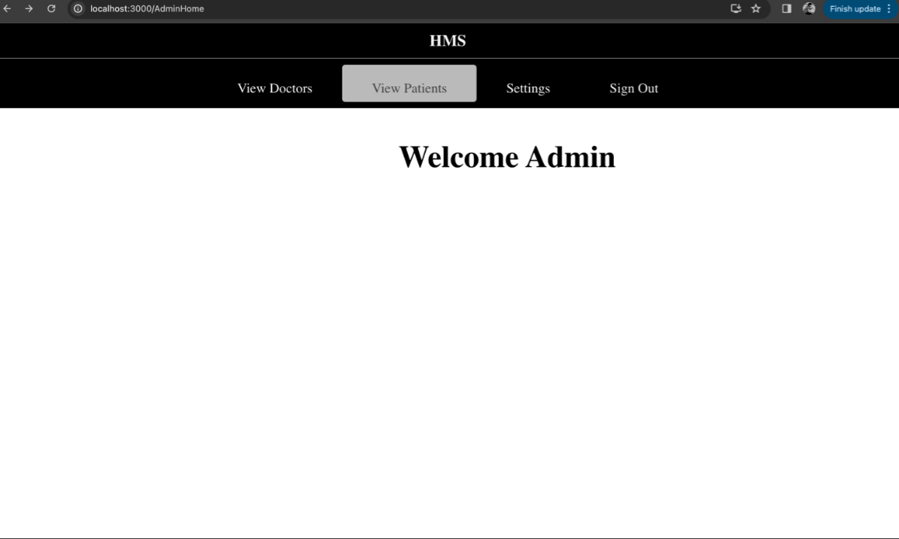
Admin Page

Slide 24
Conclusion
The project achieved to enhance the interaction between patients, doctors, Admin leading to improved administrative management and a step forward in the digital transformation of healthcare services.
The system provides a dynamic and interactive user experience with a declarative approach to UI development, while the backend is supported by Node.js and Express for efficient data processing and application logic.
Patient services are enhanced with features for viewing available doctors, ensuring data privacy, and preventing appointment clashes in the healthcare system.

